Slide 1
<IE801> Final Project [ Lunar Lander ]
[ Team 13 ]
20243199 Jiwan Kim
20243237 Hyunchul Kim
<IE801> Markov Decision Processes and Principles of Reinforcement Learning

Slide 2
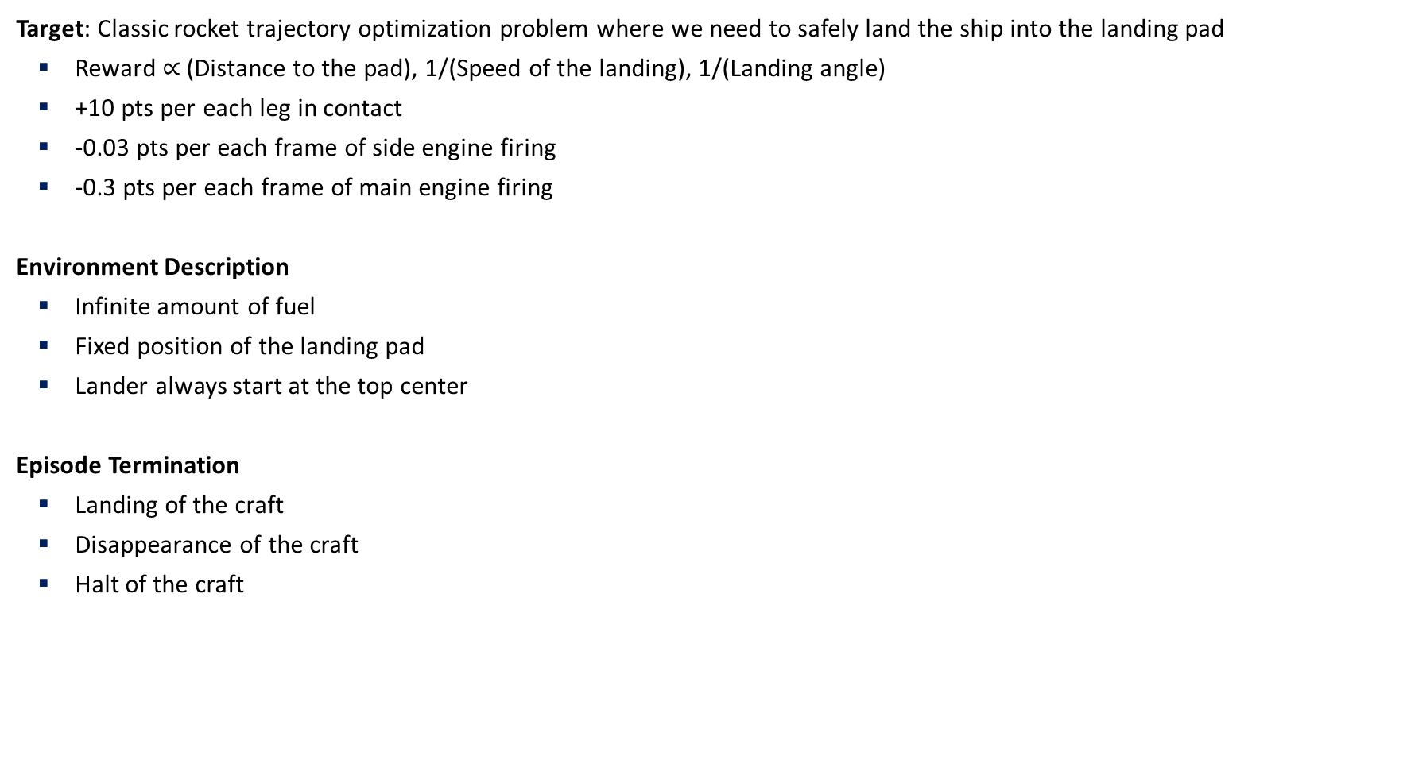
Task Analysis
Target: Classic rocket trajectory optimization problem where we need to safely land the ship into the landing pad
Reward $∝$ (Distance to the pad), 1/(Speed of the landing), 1/(Landing angle)
+10 pts per each leg in contact
-0.03 pts per each frame of side engine firing
-0.3 pts per each frame of main engine firing
Environment Description
Infinite amount of fuel
Fixed position of the landing pad
Lander always start at the top center
Episode Termination
Landing of the craft
Disappearance of the craft
Halt of the craft
https://gymnasium.farama.org/environments/box2d/lunar_lander/

Slide 3
Task Analysis
Arguments
Continuous: Whether to define continuous action space → False
Gravity: Gravity constant → -10.0
Enable_wind: Whether to introduce complex wind effects → False
Action Space
0: do nothing
1: fire left orientation engine
2: fire main engine
3: fire right orientation engine
https://gymnasium.farama.org/environments/box2d/lunar_lander/

Slide 4
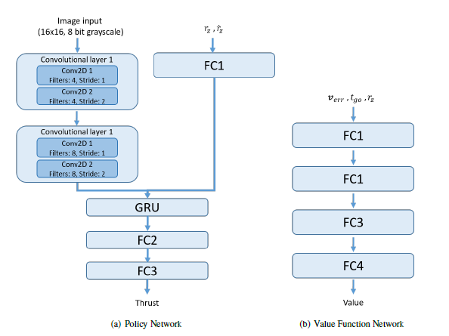
Literature Survey
“Solving The Lunar Lander Problem under Uncertainty using Reinforcement Learning”
Introduces uncertainty in the dynamics of the lander
Proposes that deep Q-Learning is more robust to uncertainty than SARSA
“Image-based Deep Reinforcement Learning for Autonomous Lunar Landing”
Agent directly learns from raw image data, making it more robust to real-world variations
Agent adapts to learn various landing scenarios
Uses CNN and RNN to capture temporal dynamics of the landing process
Policy and value function network architecture of adaptive landing algorithm

Slide 5
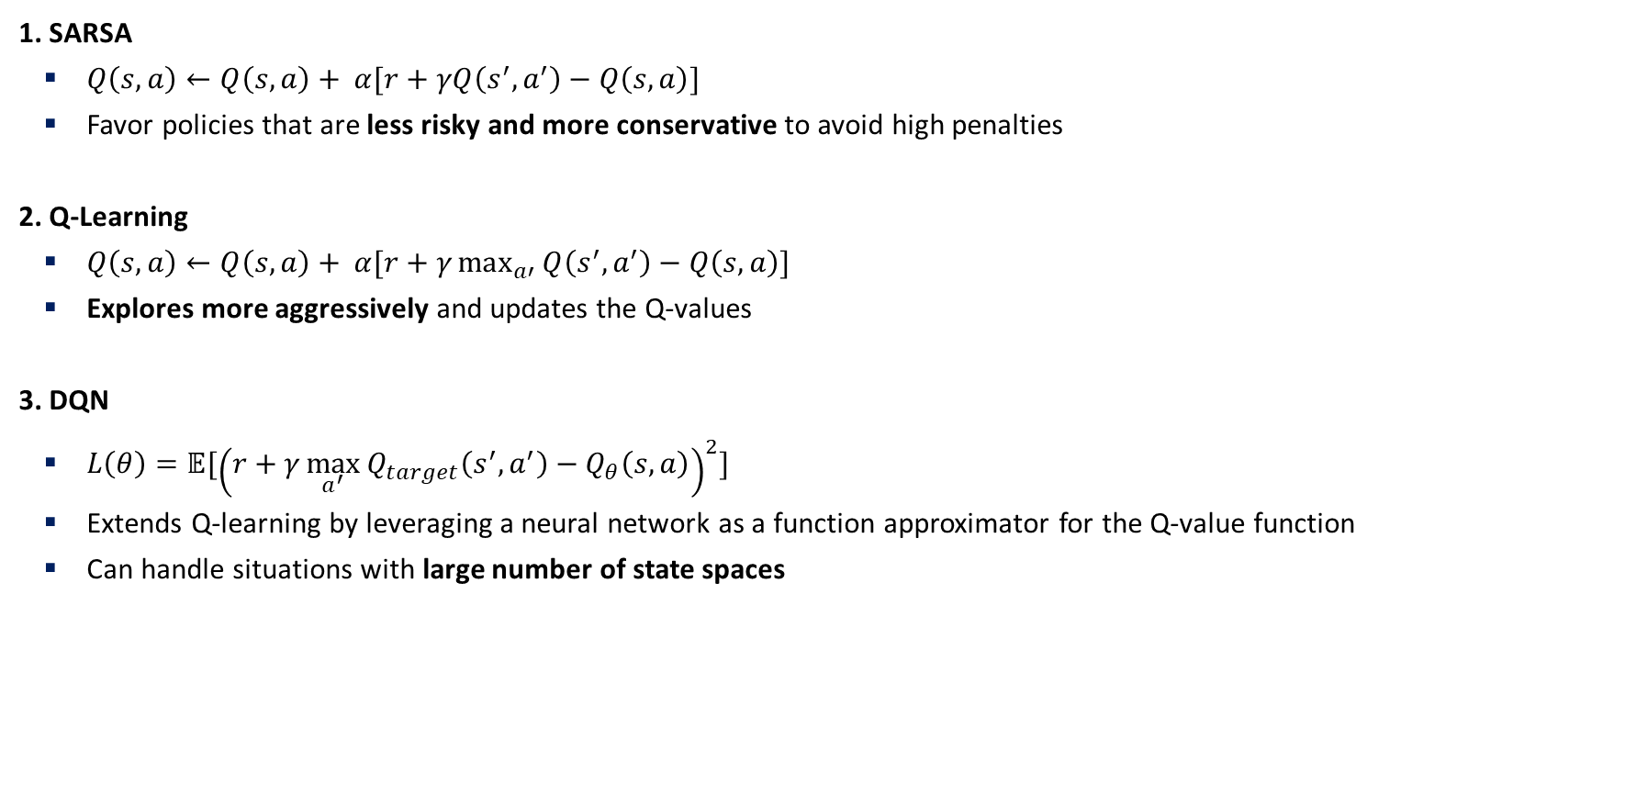
Methods
1. SARSA
$Q\left(s,a\right)←Q\left(s,a\right)+ α[r+γQ\left(s^{′}, a^{′}\right)−Q\left(s,a\right)]$
Favor policies that are less risky and more conservative to avoid high penalties
2. Q-Learning
$Q\left(s,a\right)←Q\left(s,a\right)+ α[r+γ\max_{a′}{Q\left(s^{′}, a^{′}\right)}−Q\left(s,a\right)]$
Explores more aggressively and updates the Q-values
3. DQN
$L\left(θ\right)=𝔼[{\left(r+γ\max_{a^{′}}{Q_{target}\left(s^{′}, a^{′}\right)}−Q_{θ}\left(s,a\right)\right)}^{2}]$
Extends Q-learning by leveraging a neural network as a function approximator for the Q-value function
Can handle situations with large number of state spaces

Slide 6

Experiments
Implementation details
#(Episode) $=$ 500
$α=$ 0.1
$γ=$ 0.99
Lr = 0.001
Architecture of DQN: 3-FC layers with ReLU activations
State input
Dim: [8, ]
X, Y coordinates || X, Y linear velocities || X, Y angle || X, Y angular velocity || Each leg contact
Action input
Dim: [4, ]
One-hot encoded vector of action

Slide 7
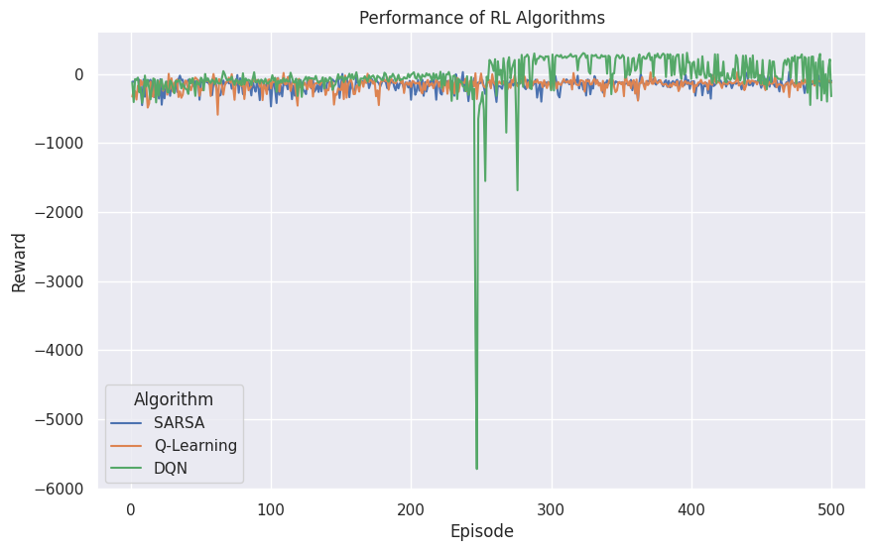
Results
Total reward output
Rewards of SARSA and Q-learning fluctuated without any significant increase
DQN achieved much higher reward
Significant drop in performance during training of DQN

Slide 8
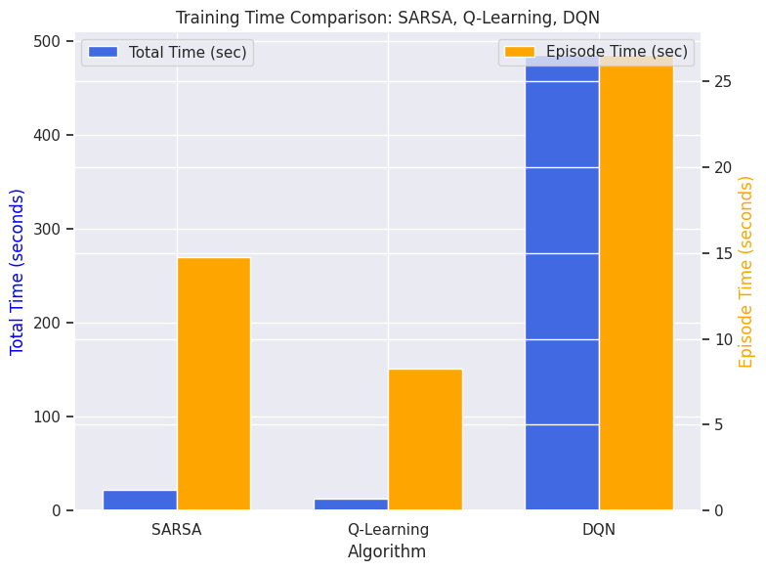
Results
Elapsed time
DQN consumed much more training time compared to SARSA and Q-Learning
Average time of generated episodes also varied significantly

Slide 9
Results
SARSA
Q-Learning
DQN

Slide 10
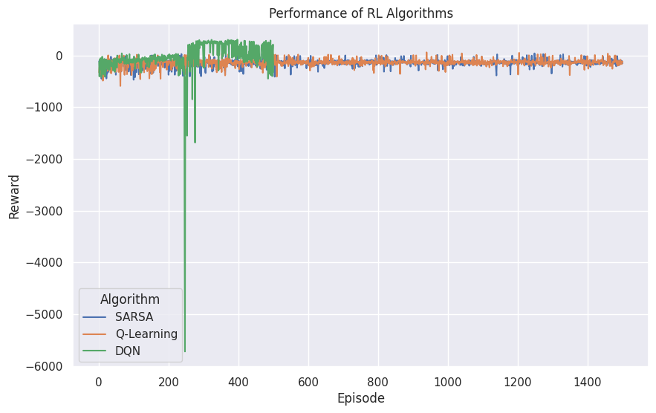
Discussion
Increasing training episodes
Training SARSA and Q-Learning with 1500 episodes did not result in better performance
Both algorithms failed to reach optimal policy

Slide 11
Discussion
Sudden drop of reward in DQN
Why?

Slide 12
Discussion
Sudden drop of reward in DQN
Why?
Episode 0
Episode 100
Episode 250
The agent learns how to safely land the craft! Since it hovered the space a long time, the reward dropped significantly

Slide 13
Conclusion
Learning Capacity
SARSA and Q-Learning failed to safely land the craft
Both algorithms seemed to settle at local minima, i.e., dropping the lander into the landing pad
However, DQN successfully managed to learn how to fly, resulting in soft landing
Learning Overhead
Computational overhead of DQN is much longer
However, DQN’s training episodes themselves are also much longer than SARSA and Q-Learning
Thus, DQN >> SARSA, Q-Learning

Slide 14
Thank You!
kim.jiwan@kaist.ac.kr, khchul@kaist.ac.kr
DSAIL @ KAIST

Slide 15
References
OpenAI Lunar Lander, https://gymnasium.farama.org/environments/box2d/lunar_lander/
Solving The Lunar Lander Problem under Uncertainty using Reinforcement Learning, Gadgil, S., Xin, Y., & Xu, C. (2020, March). Solving the lunar lander problem under uncertainty using reinforcement learning. In 2020 SoutheastCon (Vol. 2, pp. 1-8). IEEE.
Image-based Deep Reinforcement Learning for Autonomous Lunar Landing, Scorsoglio, A., Furfaro, R., Linares, R., & Gaudet, B. (2020). Image-based deep reinforcement learning for autonomous lunar landing. In AIAA Scitech 2020 Forum (p. 1910).

